Slide 1
Lecture 7: Affordances
What are we perceiving? – the object of perception
The affordance problem: action selection
perceive what actions you can perform in this environment

Slide 2
Optic flow recap
Motion and optic flow as information. Transformations in light pattern provide info about:
Layout of surfaces in surroundings
Separation of surfaces in depth
Identification of event/object
Scaling size with respect to observer
Motion of self vs. objects
Importance of exploration. Perception is active. It is an activity.

Slide 3
Previously…
Optic flow, ground theory, motion parallax, optical gradient etc are all dealing with the question of:
“How are we perceiving?”
But, what we are we perceiving? What are the objects of perception?

Slide 4
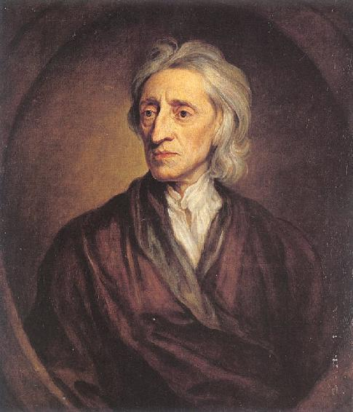

Slide 5
Following John Locke, the classic response is that the answer is to be found in the dictionary: nouns, adjectives, adverbs….
E.g. “What are you perceiving?”
-- “I perceive a chair.”
-- “I perceive a flying bird.”
-- “I perceive two beautiful ladies.”

Slide 6
Two problems facing psychologists
(1) What are the objects of perception?
(2) What is the relation between perception and language?

Slide 7
The Gibsonian (eco) proposal
We ask: “What does action require from perception?”
Affordances ← objects of perception
Affordances refer to action possibilities. Perception is for action and to perceive is to perceive action possibilities.

Slide 8
A formal definition of “Affordance”
Affordances are properties of surfaces, objects and events that are:
Real (not phenomenal, phenomenal: from the word “phenomenon”, meaning “experienced-based”),
Relational (about fit of properties of animal to properties of environment… scaling),
Functional (about action capabilities), and
Perceptible (there is information for the perceiver to pick up that specifies affordances)

Slide 9
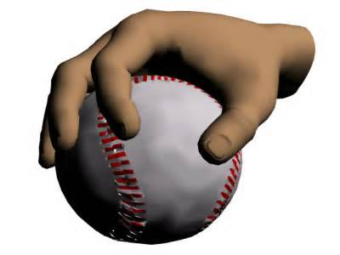
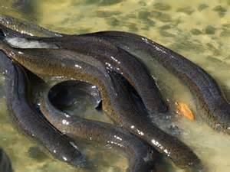
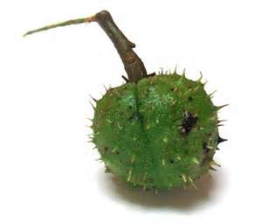
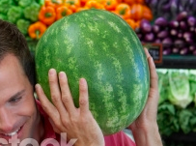

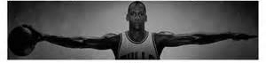
The Gibsonian (eco) proposal
Examples of affordances: the graspability of objects
Not graspable
Graspable

Slide 10
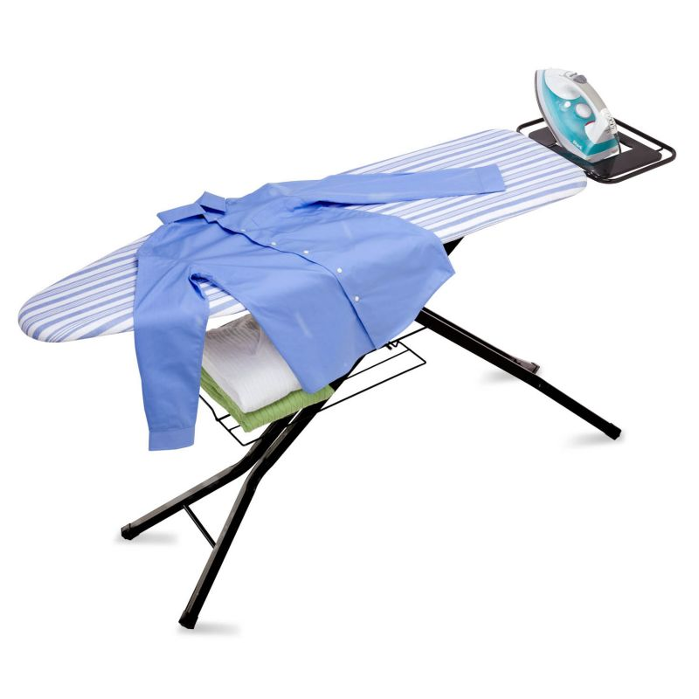
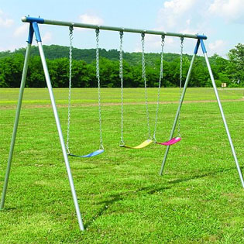
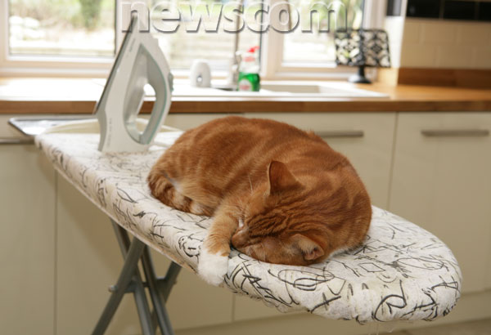
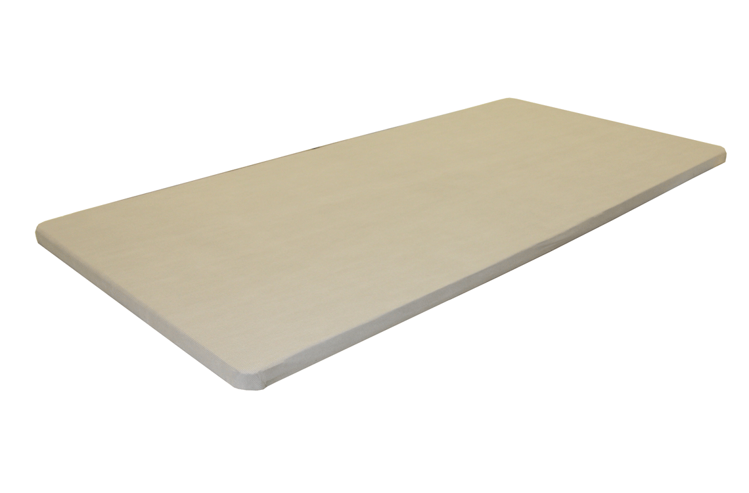
Sittablity?

Slide 11
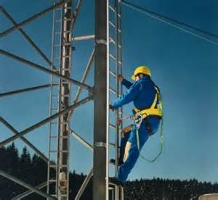
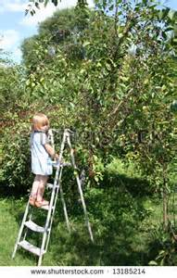
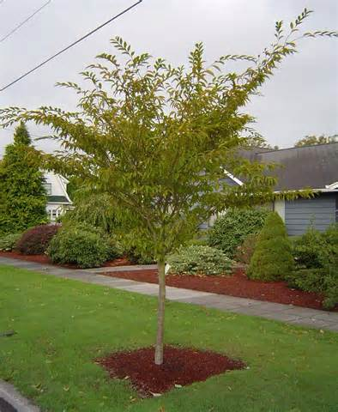
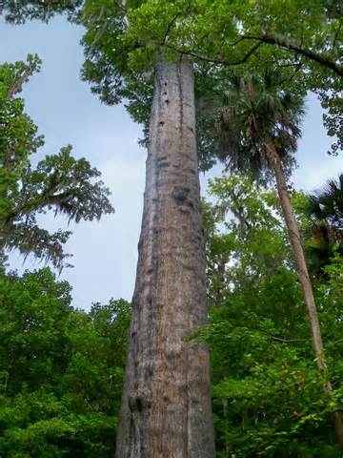
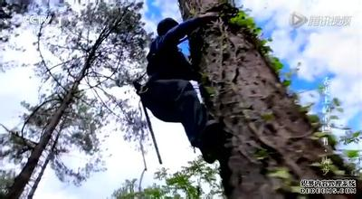
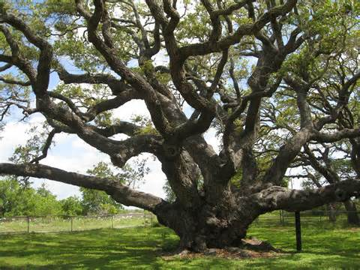
Climable?
For whom?

Slide 12
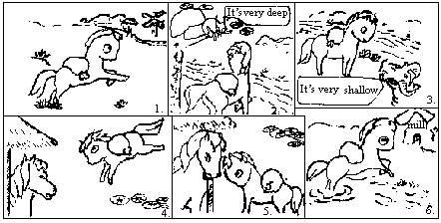

Slide 13
Measuring affordances
Affordances are about actions, so affordance terms are “verb+ability”
e.g. climbablity, throwability (an object is throwable by somebody; an object can be thrown by somebody),passibility (whether one can pass an aperture or not)
Measuring an affordance: measure the intrinsic actor-environment fit (body or action scaled to environment properties).
The tree is climable, for who?
The ratio between environment (E) and actor (A) is called the π number, which reflects how the environment is scaled in actor units.

Slide 14
Perceiving affordance – two empirical examples

Slide 15
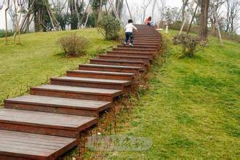
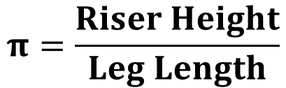
Ex 1: Perceiving climbability, Warren, 1984
Perceiving Affordances: Visual guidance of stair climbing. Warren, W. H. (1984)
$$π=\frac{Riser Height}{Leg Length}$$
Same unit, cancels out, pi is a dimensionless constant

Slide 16
Ex 1: Perceiving climbability, Warren, 1984

Slide 17
Perceiving critical climbability (Warren, 1984, Exp 1)

Slide 18
Perceiving critical climbability (Warren, 1984, Exp 1)
Look at pictures of stairway with different riser height and judge whether each stairway looked “climbable” or “unclimbable” without using your hands or knees
Climability of stairs
Climbability is relational (constant ratio)
Climbability is perceptible
67 cm
81 cm
Notes:
Short group: Leg length = 76 cm, 50% climable = 67 cm; *perceived* pi-critical = (leg length) / (50% climable) = 67/76 = 0.88 –this is the same as the calculated model prediction (equation (8))
Same for the tall group, perceived pi-critical = 0.89

Slide 19
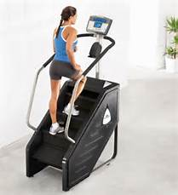
Measuring optimal climbability (Warren, 1984, Exp 2)
Optimally climbable: consuming the least energy; breathing in least O₂
Using Douglas airbag to collect and analyze O2 consumption while climbing risers of different heights for tall and short people.
19.6 cm
24.18 cm
π_{o short}=?
π_{o tall}=?
Notes:
π_{o short}=π_{o tall}=0.26

Slide 20
What should the next experiment be?

Slide 21
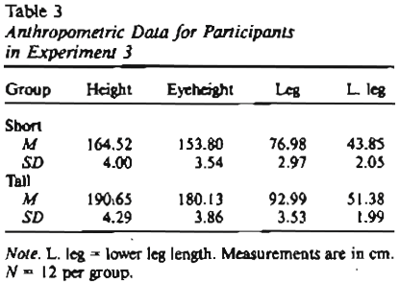
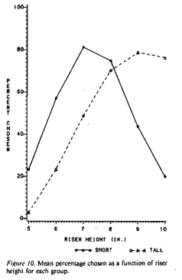
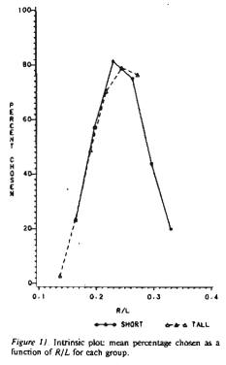
Perceiving optimal climbability (Warren, 1984, Exp 3)
Choice task:
Which one (of the two stairways) is more comfortable for you to climb?
Perceived π_{o short}=?
19 cm
23 cm
Perceived π_{o tall}=?
Notes:
Perceived π_{o short}=Perceived π_{o tall}=0.25

Slide 22
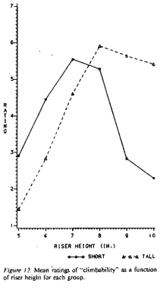
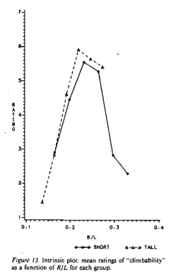
Perceiving optimal climbability (Warren, 1984, Exp 3)
Rating task:
On a scale from 1 to 7, how comfortable is this stairway for you to climb?
Perceived π_{o short}=?
18 cm
21 cm
Perceived π_{o tall}=?

Slide 23
Conclusions from Warren, 1984
Climbability depends on R/L
R/L: A relation between world objects and observers
R/L: A higher order variable
Climabability is perceptible
You can perceive the R/L ratio
Affordance is perceptible
When you perceive climbability, you are perceiving R/L, or the stair height in relation to your leg length
Affordance is relational
Finding the higher order variable that regulates P/A is the goal of eco research

Slide 24
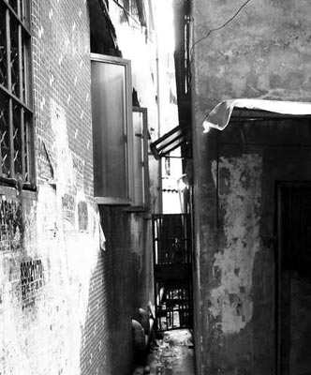
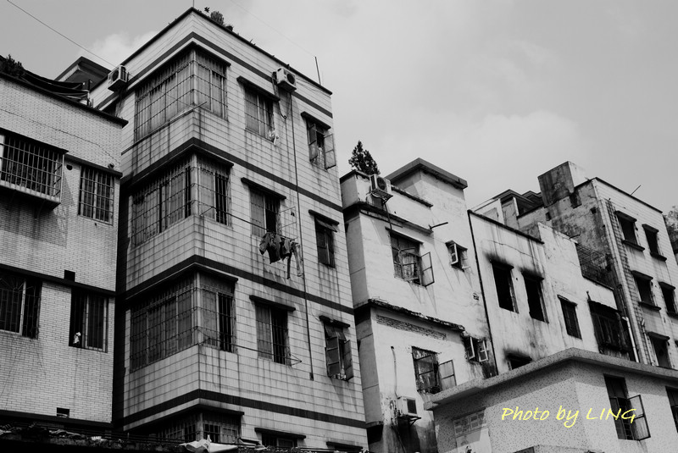
Ex 2: Perceiving Passability (Warren & Whang, 1987)
Studied passability
Find the critical π numbers for walking through apertures without and with turning shoulders

Slide 25
Measuring π_{critical} for passing through apertures (warren & Whang, 1987, Exp 1)
Is there a single higher order variable that guides passing through apertures?
How would you test this?
What results do you expect given the theories?
What can you conclude from the results about π_{critical?}
Slow walking
Fast walking
Notes:
Exp 1: tested the action of aperture passing. Aperture widths between 35 and 90cm, with 5cm increments; finally used 40 to 85cm apertures.
Small shoulder group of P’s: shoulder width = 40.4 cm, standing eye height = 157.4cm
Small shoulder group of P’s: shoulder width = 48.4 cm, standing eye height = 190.9cm
N=5 per group
Made P’s walk through diff apertures and videotaped the walking. Find out if shoulders were turned and at which aperture size.

Slide 26
Measuring π_{critical} for passing through apertures (warren & Whang, 1987, Exp 1)
π= A/S; π_{critical}=1.3
Whether one can pass through an aperture is determined by aperture-shoulder relation; and not by individuals’ shoulder width or walking speed.
Hence, the higher order variable that guides passibility (A/S ratio) is invariant across individuals and walking conditions.

Slide 27
Perceiving π_{critical} for passing through apertures (warren & Whang, 1987, Exp 2)
Exp 2: Can people perceive passibility without performing the actions?
Looking while standing still
Looking while walking
Notes:
Exp 2: tested the perception of aperture passing. Static condition: standing observers viewed aperture monocularly through a hole (allowing 90deg VF). Moving condition: moving O’s view aperture binocularly.
Small shoulder group of P’s: shoulder width = 41.4 cm, standing eye height = 164.4cm
Small shoulder group of P’s: shoulder width = 47.7 cm, standing eye height = 187.6cm
N=10 per group

Slide 28
Perceiving π_{critical} for passing through apertures (warren & Whang, 1987, Exp 2)
Exp 2: Can people perceive passibility without performing the actions?
π= A/S; perceived π_{critical}= 1.16
An individual perceives passability, or the ratio of A/S, whether (s)he is walking or standing.
Notes:
Exp 2: tested the perception of aperture passing. Static condition: standing observers viewed aperture monocularly through a hole (allowing 90deg VF). Moving condition: moving O’s view aperture binocularly.
Small shoulder group of P’s: shoulder width = 41.4 cm, standing eye height = 164.4cm
Small shoulder group of P’s: shoulder width = 47.7 cm, standing eye height = 187.6cm
N=10 per group

Slide 29
How is passability specified by optical information? (Warren & Whang, 1987, Exp 3)
OK, I can use A/S to guide my passing
But can I perceive my shoulder width?
Solution…
So, how is A/EH perceptible?

Slide 30

How is passability specified by optical information? (Warren & Whang, 1987, Exp 3)
In the optics, θ specifies height of the tree. When raising the floor surreptitiously,θ₂<θ₁, or decreased eye height leads to perceiving a shorter tree.
How do I perceive A/S? Using what optical information?
Integrating ground theory with affordance perception
θ₁
θ₂

Slide 31
How is passability specified by optical information? (Warren & Whang, 1987, Exp 3)
How is width of aperture (hence, passibility) affected by eye height(or ground level)?
α
x
)
d
)
θ
e
x = width of obj; d = distance between obj and observer; e = eye height;
α is the optical angle that specifies width x; θis the optical angle that specifies eye height

Slide 32
How is passability specified by optical information? (Warren & Whang, 1987, Exp 3)
How is width of aperture (hence, passibility) affected by eye height(or ground level)?
α
x
)
d
)
θ
e
What happens when you reduce eye-height (when the O does not know it)?
Notes:
What happens when you reduce eye-height (when the O does not know it)?
Theta reduces → tan (theta) reduces (because theta is always between 0 and 90)
Right side the equation becomes bigger
But the O does not know that e has changed
So he must think of x being larger.

Slide 33
How is passability specified by optical information? (Warren & Whang, 1987, Exp 3)
When perceiving passability, need to know A/S…

Slide 34
How is passability specified by optical information? (Warren & Whang, 1987, Exp 3)
Now you have a model that suggests perceived passability is affected by eye height, how are you going to test it?
26 cm

Slide 35
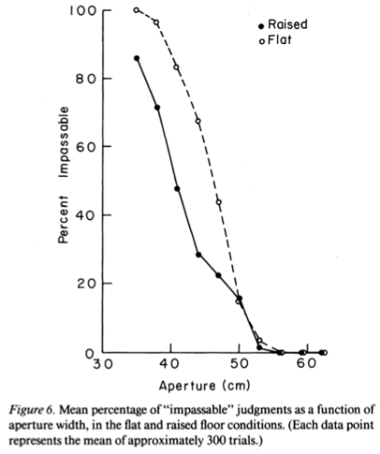
How is passability specified by optical information? (Warren & Whang, 1987, Exp 3)
Results
When raising the floor (hence reducing EH) surreptitiously, min width of aperture that affords passing decreases. Why?
(This is because reducing EH → seeing objs as wider. If you see apertures as wider, you judge you can pass through narrower apertures, as comparing to under natural viewing conditions.

Slide 36
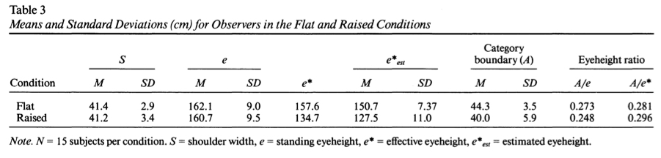
How is passability specified by optical information? (Warren & Whang, 1987, Exp 3)
Results
Changing eye height changed the min. width as being “passable”.
However, the ratio between aperture and eye height (or, π_{critical}) is still the same between the two groups!

Slide 37
Conclusions from Warren & Whang, 1987
Passability depends on A/S (or A/EH, for EH/S is a constant)
A/S: A relation between world objects and observers
A/S: A higher order variable (that is invariant when walking/standing and for various EHs)
Passability is perceptible
You can perceive the A/S ratio via EH
(learn model building)

Slide 38
Summary
What are we perceiving? Affordances
Definition of affordances
Verifying affordance perception empirically
The goal of eco research is to find the higher order variables that guides P/A via model building and experimentation.

Slide 39
Readings and Homework
Gibson (1979/1986) Chapters 8
Warren (1984)
Warren & Whang (1987).

